Slide 1
Representation of basic elementary continuous time signals
Signals and Communication Systems (SCS)
Session-3

Slide 2

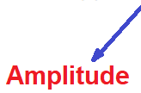
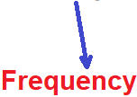
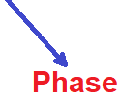

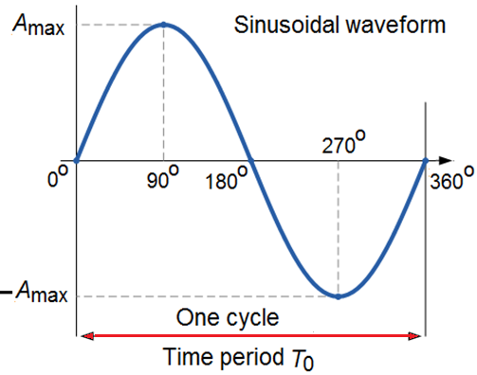




Sinusoidal signals

Slide 3

Sinusoidal signals with Phase
Phase leading Phase lagging

Slide 4
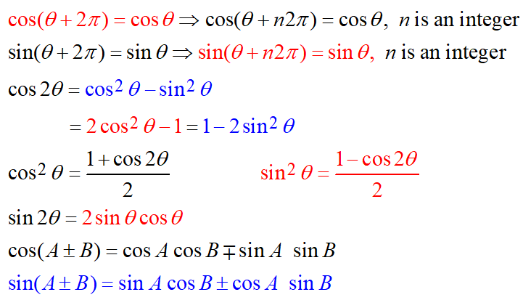
Trigonometrical Formulas

Slide 5






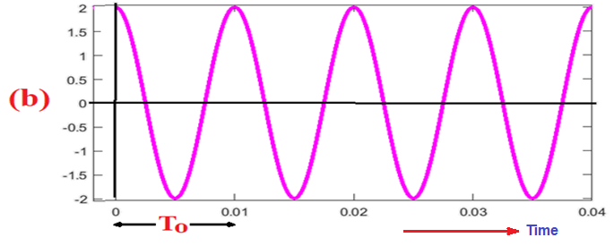

Slide 6






Slide 7




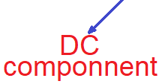
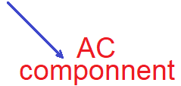


Slide 8

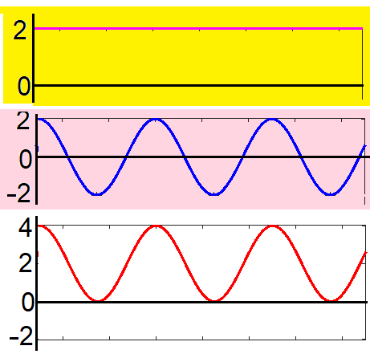
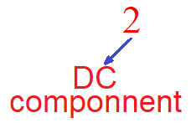
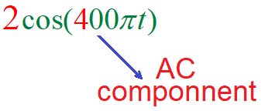
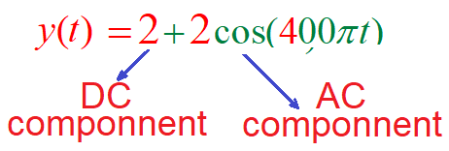
Amplitude =2
Frequency = 200 Hz

Slide 9

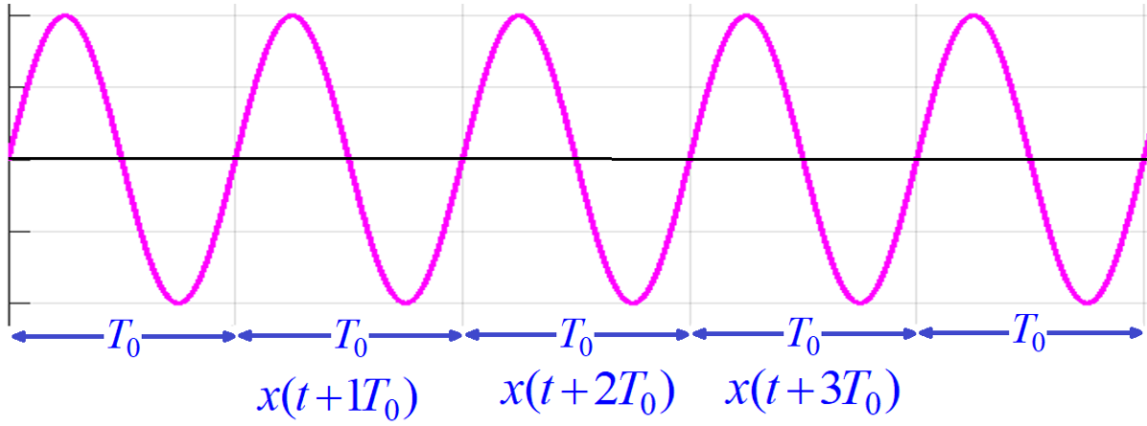
Periodicity

Slide 10







Slide 11







Slide 12




Slide 13






Slide 14
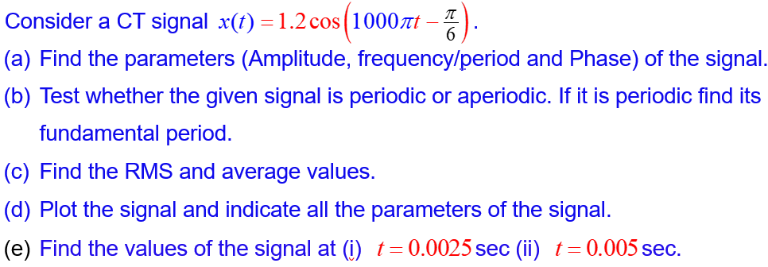


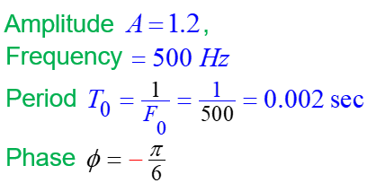


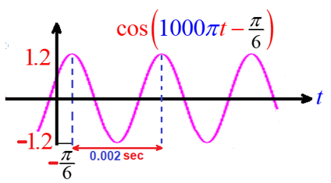


Slide 15

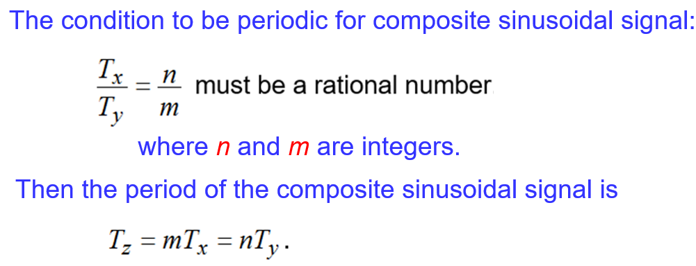
Periodicity of composite sinusoidal signals

Slide 16




Determine whether the following signals are periodic signals? If so, determine their fundamental periods.

Slide 17
Exponential Signals
The Euler’s identity provides the relation of the sinusoids with the complex exponential
The complex exponential can also be expressed in polar form as
where the notation signifies the complex function of magnitude at the angle

Slide 18
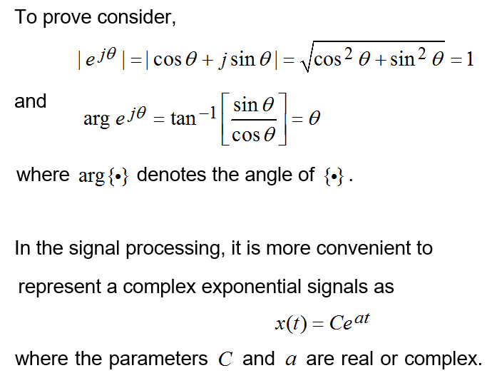

Slide 19

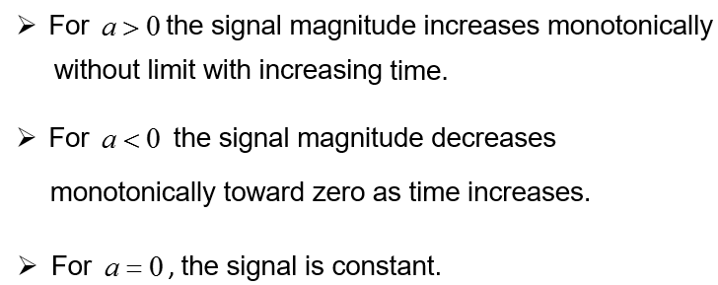

Slide 20
End

